Slide 1
Instructions
Five rounds of five questions
Combination of maths and Christmas (Christmaths?)
No calculators allowed (you won’t need them anyway ☺)
Think of a (sensible) team name and write it at the top of your answer sheet
Write your answers clearly in the correct places
Have fun!

Slide 2
Round 1
(Fairly easy)

Slide 3
R1 Q1
Identify the prime numbers:
21 23 25 27 29

Slide 4
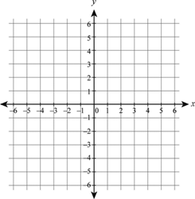
R1 Q2
What are the coordinates of point $A$?
$$×A$$

Slide 5
R1 Q3
Sharon has 12 packets of crisps. 3 are Ready Salted. 4 are Salt and Vinegar. 5 are Cheese and Onion.
What is the probability that she selects Salt and Vinegar at random?

Slide 6
R1 Q4
Calculate $\frac{2}{7}$ of $91$

Slide 7
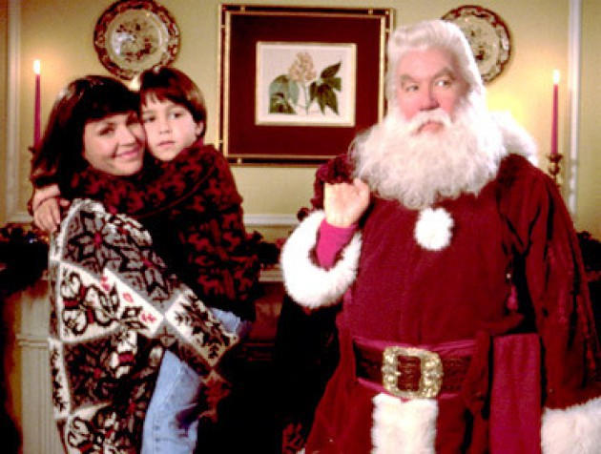
R1 Q5
Name the movie:

Slide 8
Round 1 Answers
Swap your answer sheet with a neighbouring team!
Q1: $23$ and $29$
Q2: $(−4, 2)$
Q3: $\frac{4}{12}$ or $\frac{1}{3}$
Q4: $26$
Q5: The Santa ClausE
Swap back to see how you did ☺

Slide 9
Round 2
(Not too bad)

Slide 10
R2 Q1
Calculate the Highest Common Factor of 54 and 90.

Slide 11
R2 Q2
What is the mean of the following data set:
25 21 26 28 23 27

Slide 12
R2 Q3
Calculate
$${(3−2×4)}^{2}+1$$

Slide 13
R2 Q4
Calculate
$$34×421$$

Slide 14
R2 Q5
Name the song featuring the lyrics:
“Dashing through the snow
On a one-horse open sleigh”

Slide 15
Round 2 Answers
Swap your answer sheet with a neighbouring team!
Q1: $18$
Q2: $25$
Q3: $26$
Q4: $14 314$
Q5: Jingle Bells
Swap back to see how you did ☺

Slide 16
Round 3
(A little tricky)

Slide 17
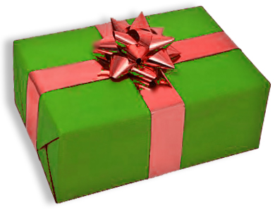
R3 Q1
Calculate the volume of the cuboid.
Don’t forget to include units in your answer!
20 cm
8 cm
35 cm

Slide 18
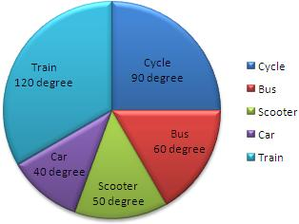
R3 Q2
1200 people were asked about how they travel to work. How many people cycle?

Slide 19
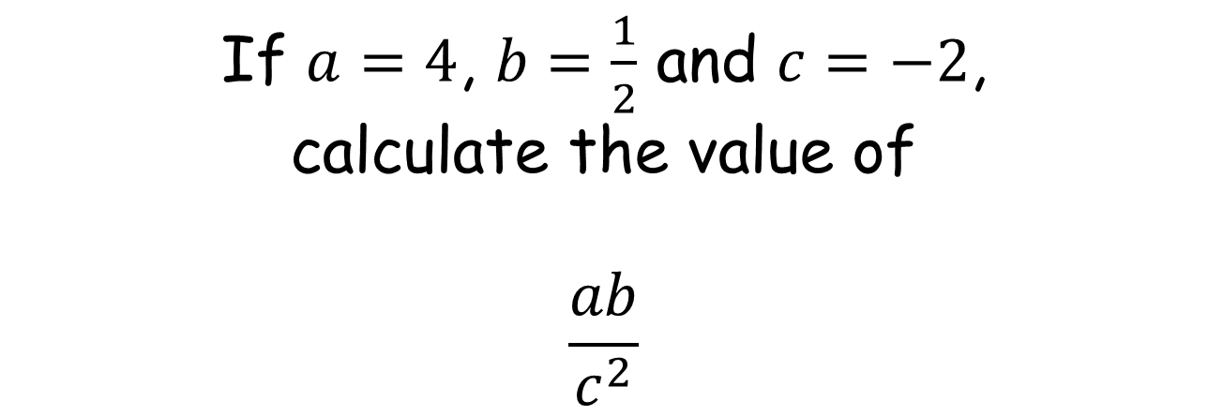
R3 Q3
If $a=4$, $b=\frac{1}{2}$ and $c=−2$,
calculate the value of
$$\frac{ab}{c^{2}}$$

Slide 20
R3 Q4
Calculate the size of the angle $x$.
$$58°$$
$$x°$$
$$47°$$

Slide 21
R3 Q5
Who wrote ‘A Christmas Carol’?

Slide 22
Round 3 Answers
Swap your answer sheet with a neighbouring team!
Q1: $5600$ cm³
Q2: $300$
Q3: $\frac{1}{2}$
Q4: $105°$
Q5: Charles Dickens
Swap back to see how you did ☺

Slide 23
Round 4
(Pretty tough)

Slide 24
R4 Q1
Calculate the n^{th} term of the sequence
4 7 10 13 16 …

Slide 25
R4 Q2
Calculate
$$\frac{2}{7}+\frac{3}{5}$$

Slide 26
R4 Q3
Calculate
63% of £40

Slide 27
R4 Q4
Round $9.8652$ to one decimal place

Slide 28
R4 Q5
Can you name all eight reindeer?

Slide 29
Round 4 Answers
Swap your answer sheet with a neighbouring team!
Q1: $3n+1$
Q2: $\frac{31}{35}$
Q3: $£25.20$
Q4: $9.9$
Q5: Dasher, Dancer, Prancer, Vixen, Comet, Cupid, Donner and Blitzen
Swap back to see how you did ☺

Slide 30
Round 5
(Hard as nails)

Slide 31
R5 Q1
Solve:
$$4x+7=41$$

Slide 32
R5 Q2
Calculate the area of the circle.
20 cm

Slide 33
R5 Q3
Calculate
$$3\frac{2}{3}÷2\frac{3}{8}$$

Slide 34
R5 Q4
Simplify:
$$\frac{{3x}^{3} ×4x^{5}}{{2x}^{6}}$$

Slide 35
R5 Q5
What colour did Father Christmas used to wear before he wore red?

Slide 36
Round 5 Answers
Swap your answer sheet with a neighbouring team!
Q1: $8.5$
Q2: $314 {cm}^{2}$
Q3: $1\frac{31}{57}$
Q4: ${6x}^{2}$
Q5: Green
Swap back to see how you did ☺

