Slide 1
















Starter
Calculate angles $a$ to $f$.
$$44°$$
$$38°$$
$$41°$$
$$e$$
$$68°$$
$$68°$$
$$71°$$
$$71°$$
$$a$$
$$b$$
$$c$$
$$d$$
$$f$$
$$59°$$
$$31°$$
Extension: Can you give reasons for your answers?

Slide 2
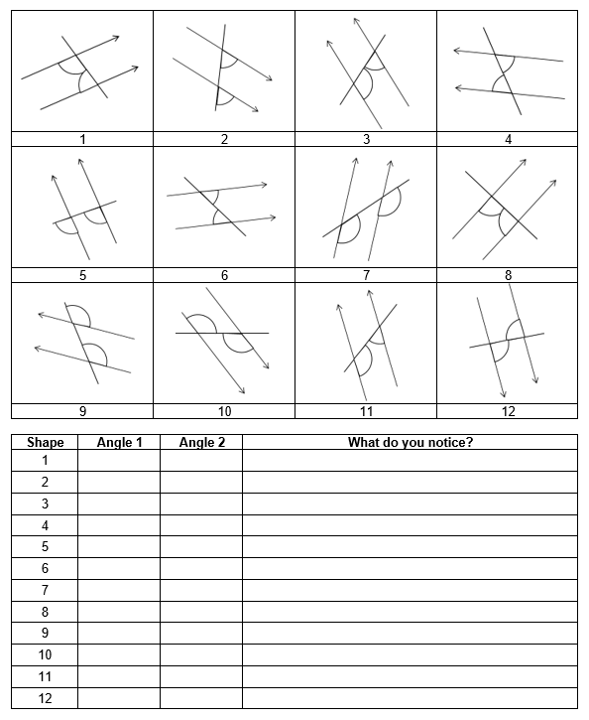
Parallel Lines Investigation
Work in pairs.
Measure both angles in each diagram and write down your observations.
Check that you have measured accurately!

Slide 3
Parallel Lines Investigation

Slide 4





$$a$$
$$b$$
$$d$$
$$c$$
Alternate angles are equal
$a=c$ and $b=d$
They make a Z shape

Slide 5





$$b$$
$$a$$
$$d$$
$$c$$
Corresponding angles are equal
$a=c$ and $b=d$
They make an F shape

Slide 6



$$a$$
$$b$$
Co-interior angles add up to $180°$
$$a+b=180°$$
They make a C shape

Slide 7
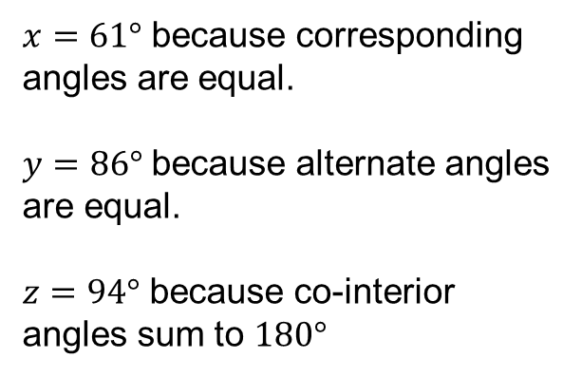


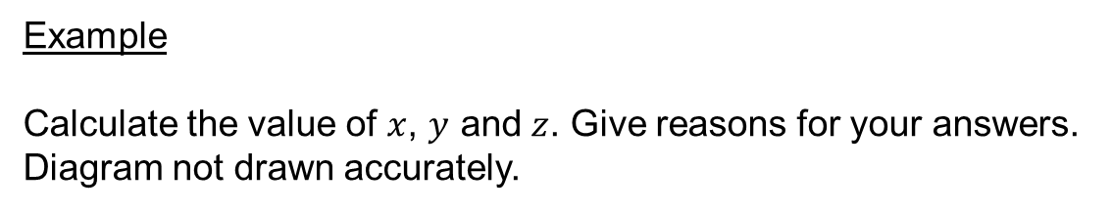




Example
Calculate the value of $x$, $y$ and $z$. Give reasons for your answers. Diagram not drawn accurately.
$x=61°$ because corresponding angles are equal.
$y=86°$ because alternate angles are equal.
$z=94°$ because co-interior angles sum to $180°$
$$86°$$
$$z$$
$$61°$$
$$y$$
$$x$$
Can you think of a different reason we could have given for $z$?

Slide 8
Make sure you provide reasons for EVERY answer!

Slide 9
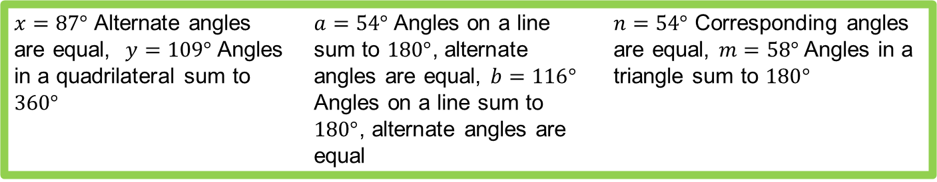
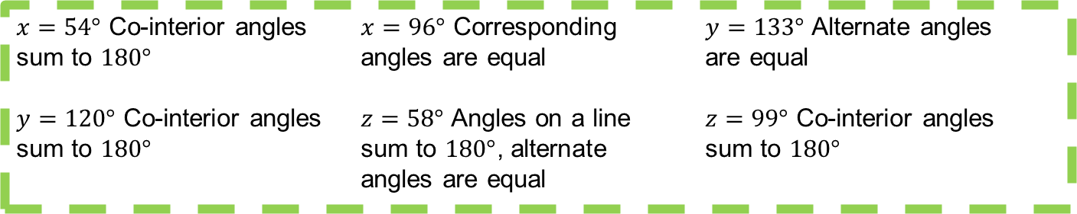
Answers
$x=48°$ Alternate angles $z=42°$ Co-interior angles $y=61°$ Corresponding
are equal sum to $180°$ angles are equal
$x=54°$ Co-interior angles $x=96°$ Corresponding $y=133°$ Alternate angles
sum to $180°$ angles are equal are equal
$y=120°$ Co-interior angles $z=58°$ Angles on a line $z=99°$ Co-interior angles
sum to $180°$ sum to $180°$, alternate sum to $180°$
angles are equal
$x=87°$ Alternate angles $a=54°$ Angles on a line $n=54°$ Corresponding angles
are equal, $y=109°$ Angles sum to $180°$, alternate are equal, $m=58°$ Angles in a
in a quadrilateral sum to angles are equal, $b=116°$ triangle sum to $180°$
$360°$ Angles on a line sum to
$180°$, alternate angles are
equal

