Slide 1
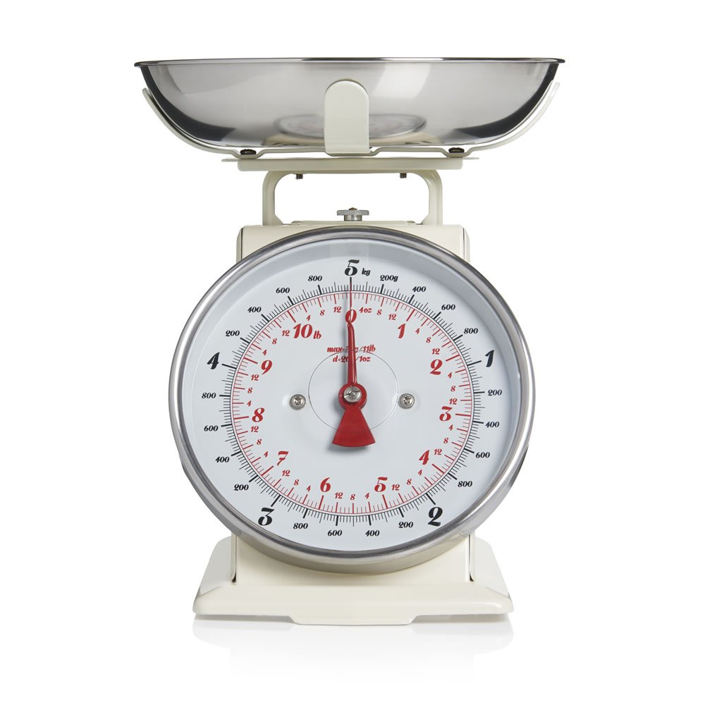
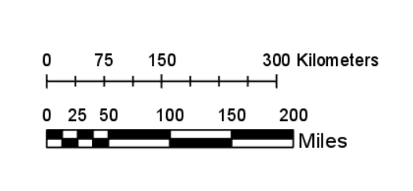
Starter
Write down as many examples as you can where we would use a scale.
For example, on a map.
This Photo by Unknown Author is licensed under CC BY-SA

Slide 2
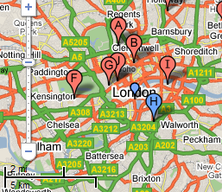
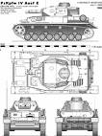
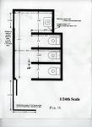
Scale Drawings
On Maps
Vehicle design
Footprints of houses

Slide 3
Scale drawing allows us to draw large objects on a smaller scale while keeping them accurate.
All scale drawings must have a scale written on them. Scales are usually expressed as ratios.
Example
The ratio 1 cm : 100 cm means that for every 1 cm on the scale drawing the length will be 100 cm in real life

Slide 4
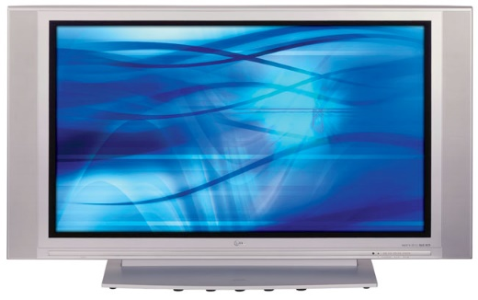
4x25= 100cm
4cm
2cm
2x25 = 50cm
The scale of this drawing is 1cm = 25cm
What is the actual width and height of the TV ?

Slide 5
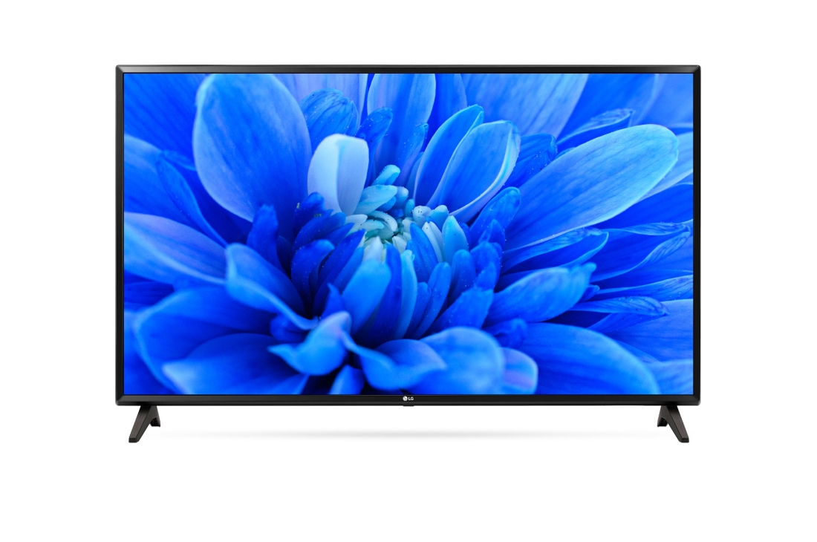
Example
The scale of this picture is 1 : 25
What are the actual dimensions of this TV?
4 $×$ 25 = 100 cm
2.5 $×$ 25 = 62.5 cm
Multiply both sides by the scale
4 cm
2.5 cm

Slide 6
Your Turn
Using a scale of 1 cm : 9 m accurately draw this right angled triangle in your books.
45 m
5 cm
27 m
3 cm
36 m
4 cm

Slide 7
Extension: Complete the skyscrapers activity.

Slide 8
Answers
3 cm 8 cm
1.5 cm 4 cm
6 cm 16 cm
30 cm 80 cm
15 cm 40 cm

Slide 9
Plenary
Draw the following cinema screens in your book… to a scale of your choice! Draw all of them on top of each other to compare the screens.
A standard cinema screen is 9m tall and 21m wide.
The London BFI IMAX screen is 26m wide and 20m tall.
The world’s largest screen is the Sydney LG IMAX. It is 38m wide and 30m tall.

